Slide 2
Outline:
The problem we need to solve and overview of the data
Unsupervised learning and supervised learning approach
EDA
PCA and clustering
Result
Github link:
https://github.com/carsonxie/Machine-Learning-Projects/tree/main/c2%20Unsupervised%20Learning%20method

Slide 3
What problem are we trying to solve?
Goal: To predict high dim tabular belong to class 0 or 1?
Tabular data, high dimension
(250,300)
Class 0
A Classifier
Class 1

Slide 4
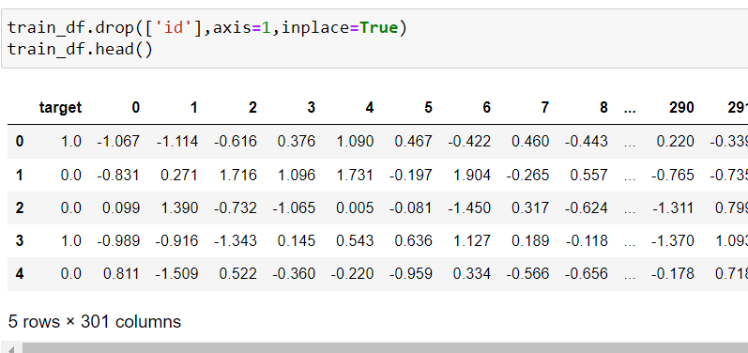
Overview of the data
Original train dataset: shape (250,300)

Slide 5
Unsupervised method
Question to ask myself: Is the data suitable for applying PCA?
What is the appropriate k(number of components) ?
Can PCA improve unsupervised model’s performance?
What about Supervised learning method？
Notes:
Kmean and hierarchy clustering

Slide 6
Code go through
https://github.com/carsonxie/Machine-Learning-Projects/blob/main/c2%20Unsupervised%20Learning%20method/final2%20project.ipynb

Slide 7
Result
Improvement on PCA
When to use PCA
Possible reason that PCA didn’t improve model score
Features are not redundant, not many noise in the features
https://towardsdatascience.com/pca-clearly-explained-how-when-why-to-use-it-and-feature-importance-a-guide-in-python-7c274582c37e#:~:text=When%2FWhy%20to%20use%20PCA,for%20denoising%20and%20data%20compression.

Slide 8
Thank you for watching !

